Slide 1

Servlets
URLs
Request Object
Request Parameters
Response Object
Hi/Lo Example

Slide 2

See Also
http://www.tutorialspoint.com/servlets/
http://www.oracle.com/technetwork/java/index-jsp-135475.html
Notes:
Some additional information on concurrency

Slide 3
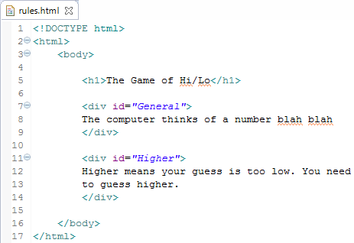
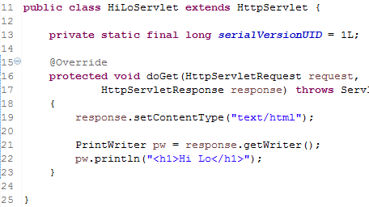
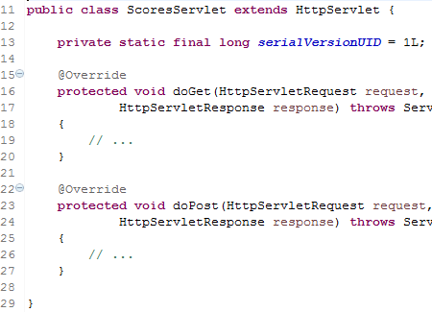
URL Mappings
GET
http://1.2.3.4/
welcome
GET
http://1.2.3.4/rules.html#Higher
GET
http://1.2.3.4/rules.html?value=20
GET
http://1.2.3.4/guess?value=20
GET
http://1.2.3.4/scores
GET
http://1.2.3.4/scores#topTen
http://1.2.3.4/scores
POST
Streams of bytes … two ways (into your program and out of your program)
Disks, consoles, sockets, keyboards, printers
Know how to talk streams and you can talk to anything
Initialization (constructor) is different. Use is the same.

Slide 4

Extends HttpServlet
public class HiLoServlet extends HttpServlet {
private static final long serialVersionUID = 1L;
@Override
protected void service(
HttpServletRequest request,
HttpServletResponse response)
throws IOException, ServletException
{
String s = request.getMethod();
switch(s) {
case "GET":
case "POST":
case "PUT":
}
}
}
Streams of bytes … two ways (into your program and out of your program)
Disks, consoles, sockets, keyboards, printers
Know how to talk streams and you can talk to anything
Initialization (constructor) is different. Use is the same.

Slide 5
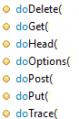
Extends HttpServlet
public class HiLoServlet extends HttpServlet {
private static final long serialVersionUID = 1L;
// default service() calls these ...
@Override
protected void doGet(HttpServletRequest request,
HttpServletResponse response)
{
System.out.println("In doGet");
}
@Override
protected void doPost(HttpServletRequest request,
HttpServletResponse response)
{
System.out.println("In doPost");
}
}
Streams of bytes … two ways (into your program and out of your program)
Disks, consoles, sockets, keyboards, printers
Know how to talk streams and you can talk to anything
Initialization (constructor) is different. Use is the same.

Slide 6
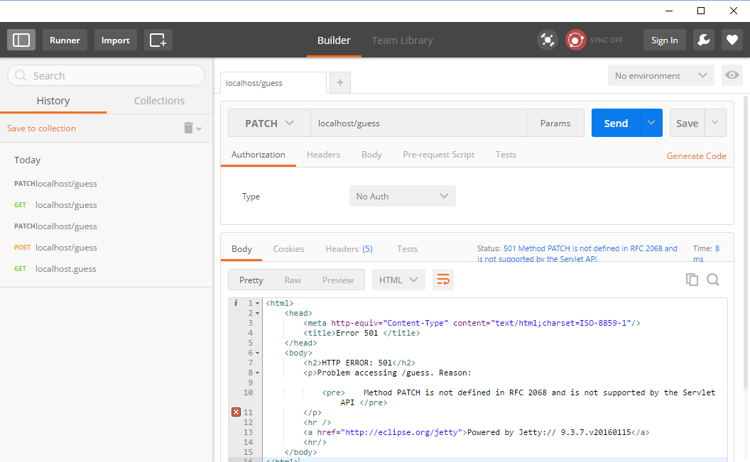
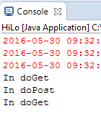
Chrome “Postman”
Streams of bytes … two ways (into your program and out of your program)
Disks, consoles, sockets, keyboards, printers
Know how to talk streams and you can talk to anything
Initialization (constructor) is different. Use is the same.

Slide 7
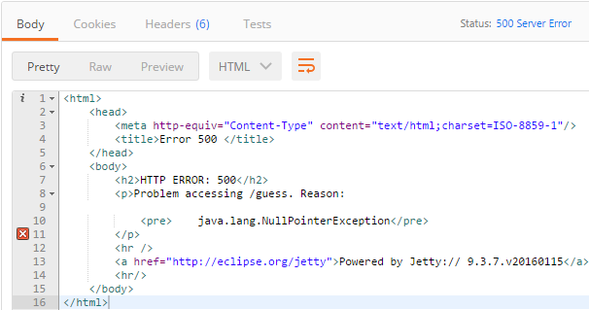
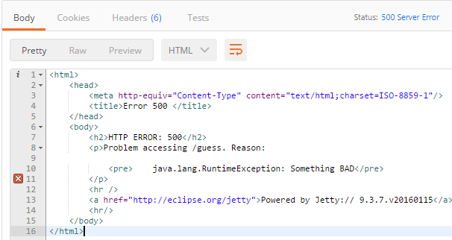
Exceptions
@Override
protected void doGet(HttpServletRequest request,
HttpServletResponse response)
{
throw new RuntimeException("Something BAD");
String s = null;
s.length();
System.out.println("In doGet");
}
Streams of bytes … two ways (into your program and out of your program)
Disks, consoles, sockets, keyboards, printers
Know how to talk streams and you can talk to anything
Initialization (constructor) is different. Use is the same.

Slide 8
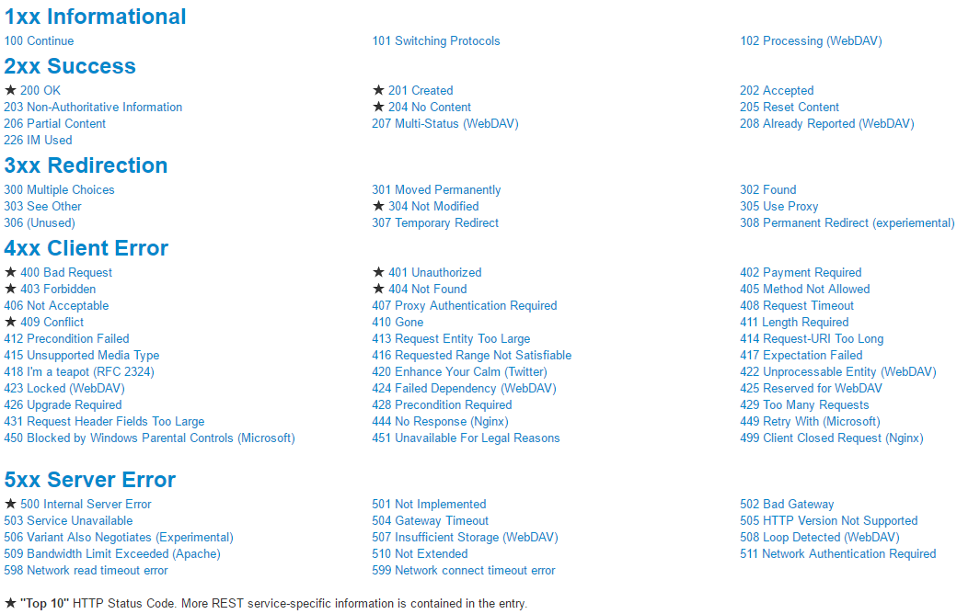
Streams of bytes … two ways (into your program and out of your program)
Disks, consoles, sockets, keyboards, printers
Know how to talk streams and you can talk to anything
Initialization (constructor) is different. Use is the same.

Slide 9
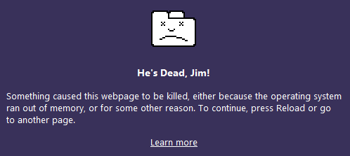
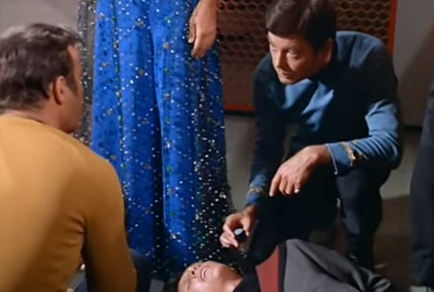
Status and Content
Content can be anything you want
Errors are often HTML to be shown in the browser (like a friendly 404)
Errors could be an object
@Override
protected void doGet(HttpServletRequest request,
HttpServletResponse response) throws IOException
{
response.setStatus(HttpServletResponse.SC_OK); //(200)
response.setStatus(403);
PrintWriter pw = response.getWriter();
response.setContentType("text/html");
pw.println("<html><body><h1>Hello</h1></body></html>");
response.setContentType("application/xml");
pw.println("<items><i>1</i><i>2</i><i>3</i></items>");
response.setContentType("application/json");
pw.println("[1,2,3]");
}
Streams of bytes … two ways (into your program and out of your program)
Disks, consoles, sockets, keyboards, printers
Know how to talk streams and you can talk to anything
Initialization (constructor) is different. Use is the same.

Slide 10
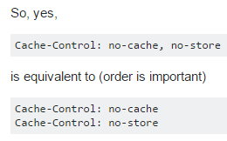
HttpServletRequest
Enumeration<String> names = request.getHeaderNames();
Enumeration<String> values = request.getHeaders("Accept-Language");
String h1 = request.getHeader("Topher");
int h2 = request.getIntHeader("Content-Length");
int len = request.getContentLength();
long lenlong = request.getContentLengthLong();
String type = request.getContentType();
Cookie[] cookies = request.getCookies();
String uri = request.getRequestURI();
BufferedReader br = request.getReader();
InputStream is = request.getInputStream();

Slide 11
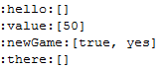
Request Parameters
Map<String, String[]> params = request.getParameterMap();
for(Entry<String, String[]> e : params.entrySet()) {
System.out.println(":"+e.getKey()+":"+Arrays.toString(e.getValue()));
}
String a = request.getParameter("newGame"); // Just the first one
String [] b = request.getParameterValues("newGame"); // All of them
HTML forms send “application/x-www-form-urlencoded” content
Automatically decoded into parameters
Use the input stream for other types of content

Slide 12
HttpServletResponse
response.setStatus(HttpServletResponse.SC_OK);
response.setHeader("Content-Type", "plasma");
response.setContentType("text/html");
response.addCookie(new Cookie("state", "1234567"));
PrintWriter pw = response.getWriter();
OutputStream os = response.getOutputStream();

Slide 13
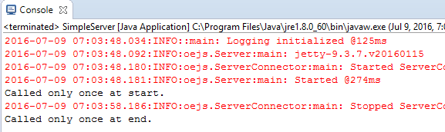
Life Cycle
public class HelloServlet extends HttpServlet {
@Override
public void init() throws ServletException {
System.out.println("Called only once at start.");
}
@Override
public void destroy() {
System.out.println("Called only once at end.");
}
...
Server server = new Server(80);
server.start();
Thread.sleep(10_000);
server.stop();

Slide 14

Hi/Lo Example
Here’s how to play
<input> <Guess>
GET http://1.2.3.4/hilo
POST http://1.2.3.4/hilo
guess=20
Higher/Lower
<input> <Guess>
You got it!
<Play Again Button>

Slide 15

Tinkering
Draw up some design notes for the Hi/Lo game.
Stub out the processing Servlet.
Tinker with HTML fragments you want to use in the game.

